Slide 1
ELEC2208:
Power Electronics and Motor Drives
Coursework/Lab intro

Slide 2
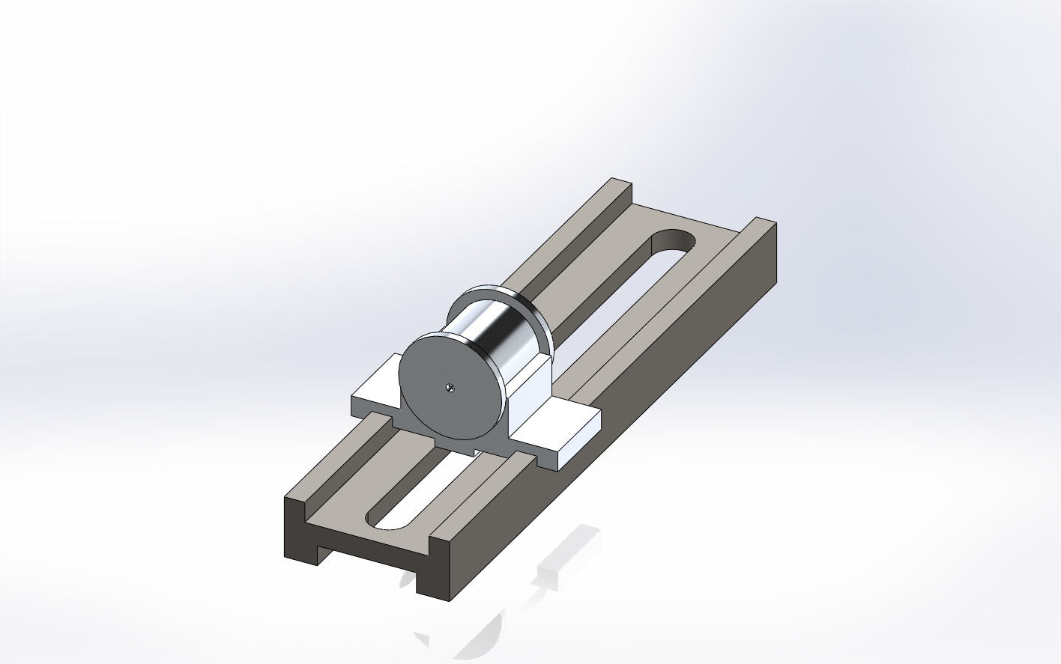
The Test system
The purpose of this request is to size the system and select suitable components for a ballscrew based drive system for the application.
The test article is filled with one of three liquids,
methyl alcohol ( (ρ =785 kgm⁻³),
pure water (ρ = 1000 kgm⁻³) ,
1,2,4-Trichlorobenzene (ρ = 1454kgm⁻³).
The system’s maximum speed is such that the load can move a predefined distance in a predefined time,
The motion profile is a cubic polynomial
After completion of a move, the drive reverses. The motion profiles being identical - this motion continues for a considerable period of time.

Slide 3
The Test system
No gear box is to be used.
The carriage structure is manufactured from aluminium (ρ = 2700 kgm⁻³) and the test article from nylon, (ρ = 1140 kgm⁻³).
The friction coefficient (µ) between the carriage and the slideway will not exceed 0.1, due to the provision of a lubrication system.
A linear positional measurement is required. The required resolution is 10⁻⁵m.
The ball screw is manufactured from steel (ρ = 7850 kgm⁻³) and has a radius of 15mm, length of 1.6m and efficiency of 85%. You can assume that the nut and the associated hardware to connect the nut to the carriage has a total mass of 0.5kg.

Slide 4
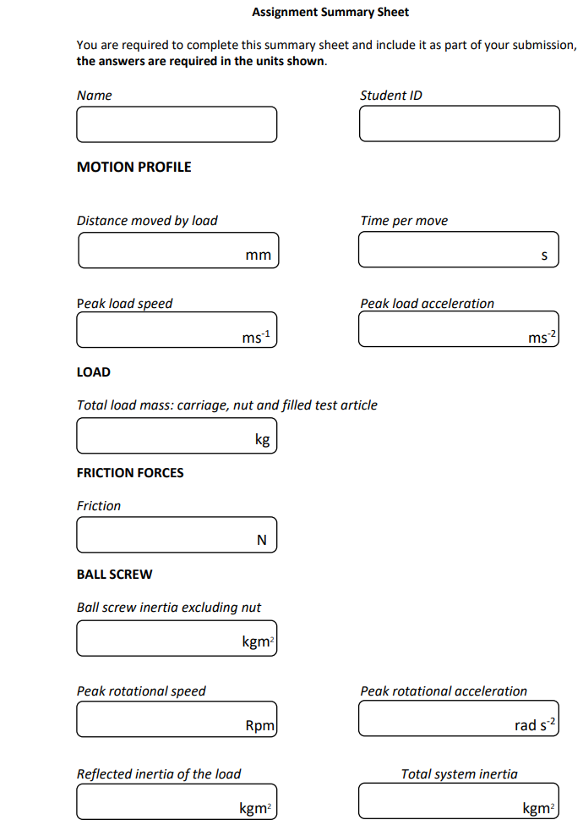
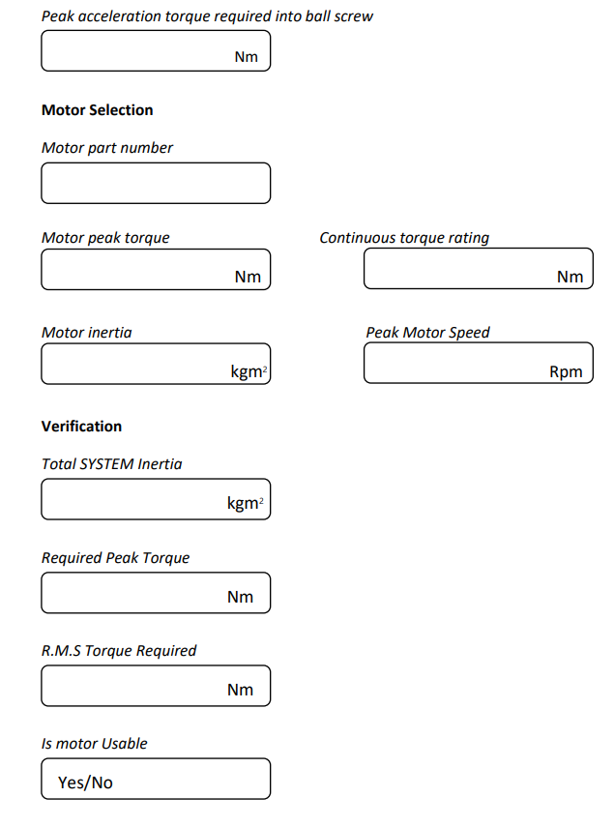
Format
Variables given
T (sec)
Distance (mm)
Liquid
Lead (mm)

Slide 5
Expectations
The assignment is worth 15% of the module and will be assessed as follows:
• Sizing the application. 70 Marks
• Indicative detailed diagram and components, including provision of limit and datum switches. 30 Mark
Sizing the application
  Detailed calculations must be provided for each answer
  Explanation justifying the choice of motor must be given
Diagrams
  Details(drawings + use of the component in the system) must be provided for each components in the system
  Diagram of the full system outlining each of the components used

Slide 6
ELEC2208:
Power Electronics and Motor Drives
EE75 lab

Slide 7
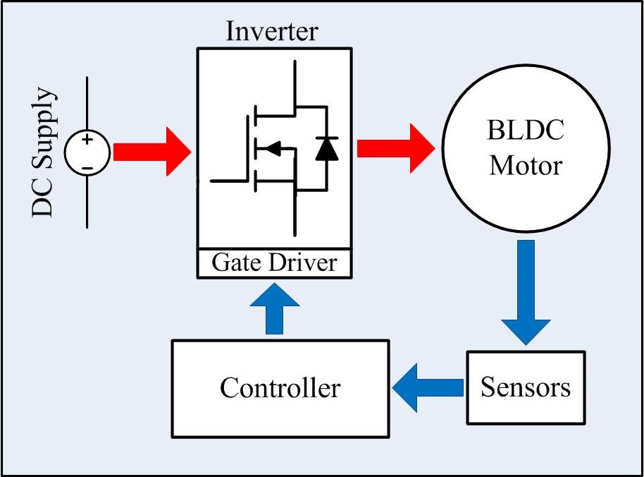
Aims, Learning Outcomes and Outline
This coursework based on the laboratory exercise aims to:
  Develop the skills required to integrate power electronics with a microcontroller
  Demonstrate the operating principle of a BLDC motor and its drive system
  Having successfully completed this coursework, you will be able to:
  Implement a fixed frequency three-phase inverter
  Construct the commutation tables for a BLDC
  Control a BLDC motor
The exercise introduces an electric drive system for BLDC motor.
The switching scheme of the drive system will be investigated through the construction commutation tables and associated PWM signalling.

Slide 8


Slide 9
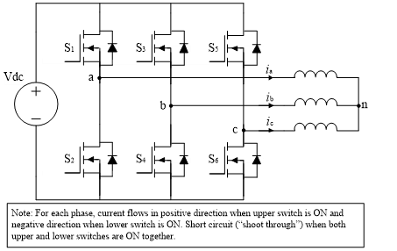
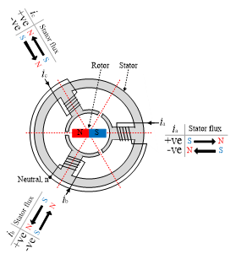

Slide 10
LAB output
Background questions as preparation work
Code is given to you to drive Mosfets
Compute commutation tables for both clockwise (CW) and counter-clockwise (CCW) directions
Sketch the PWM signals of BLDC motor in CW and CCW directions with respect to the Hall sensor signals

